Slide 1



TOPIC: Solving Quadratics by completing the square
EQ: How do I factorise a perfect square trinomial?
$$Example: x^{2}−4x−13=0$$
This cannot be factored in our normal case we done previously. We need to do something called the perfect square trinomial
Creating the perfect square trinomial – Steps
1) Get your constant to the other side
$$x^{2}−4x−13+13=0+13$$
$$x^{2}−4x=13$$

Slide 2
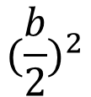


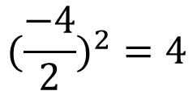

TOPIC: Solving Quadratics when there is a zero
EQ: How do I factorise a perfect square trinomial?
$$x^{2}−4x=13$$
2) Find the new value (use the formula)
$$(\frac{b}{2})^{2}$$
$$(\frac{−4}{2})^{2}=4$$
$$x^{2}−4x=13$$
$${(x}^{2}−4x+4)=13$$

Slide 3



TOPIC: Solving Quadratics when there is a zero
EQ: How do I factorise a perfect square trinomial?
$${(x}^{2}−4x+4)=13$$
2) Go back to solving equations – if you do something on one side what do you do on the other side? The same thing
$${(x}^{2}−4x+4)=13+4$$
3) Now write the equation as a perfect square
$$(x−2)^{2}=17$$

Slide 4

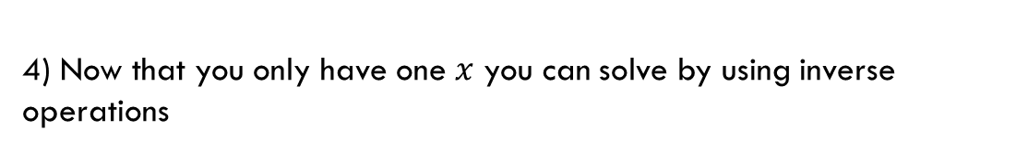



TOPIC: Solving Quadratics when there is a zero
EQ: How do I factorise a perfect square trinomial?
4) Now that you only have one $x$ you can solve by using inverse operations
$$(x−2)^{2}=17$$
You need to undo the exponent of 2 so square root both sides
$$√(x−2)^{2}=√17$$
$$x−2=±√17$$
$$x−2=±√17$$

Slide 5




TOPIC: Solving Quadratics when there is a zero
EQ: How do I factorise a perfect square trinomial?
You now need to get $x$ by itself
$$x−2=±√17$$
$$+2 +2$$
$$x=2±√17$$

Slide 6

Lets do another one together
$$x^{2}+16x−7=0$$

Slide 7
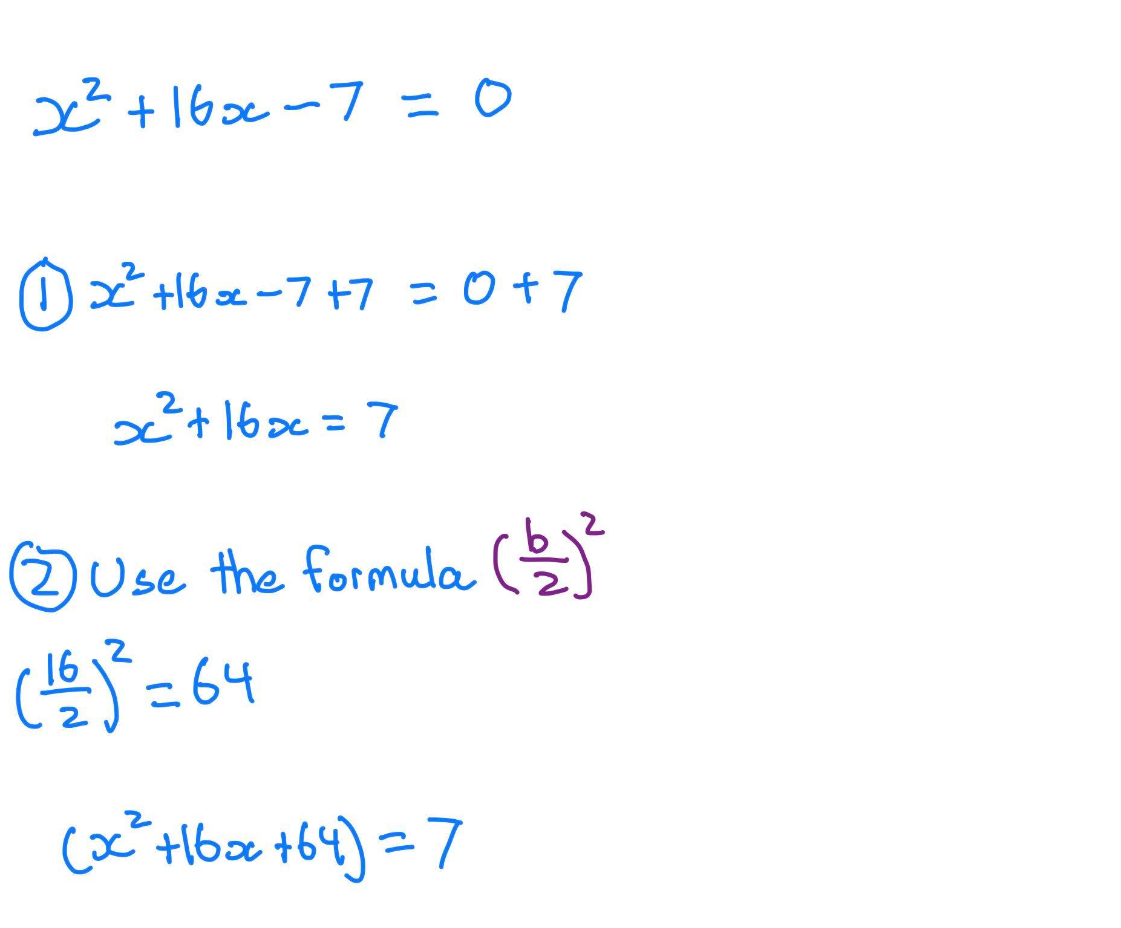

Slide 8
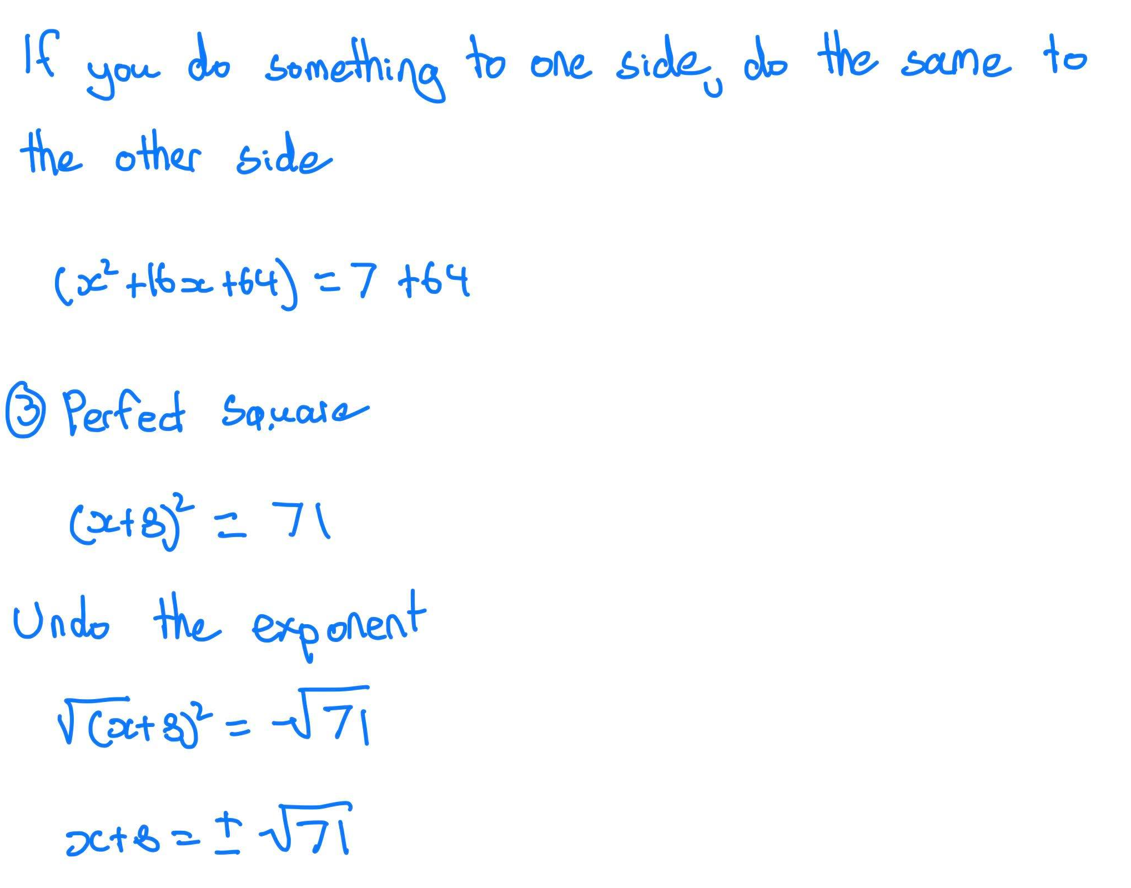

Slide 9
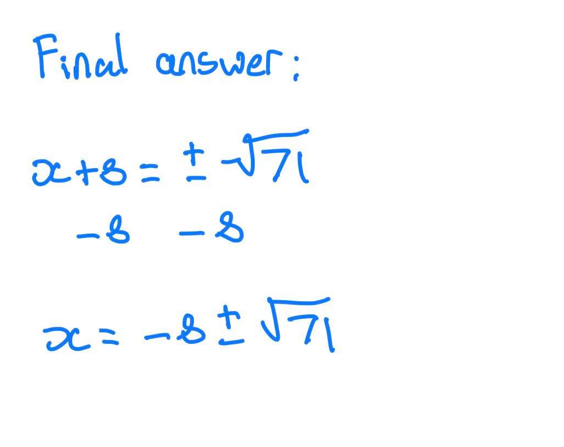

Slide 10






LHS
$$x^{2}+12x+32=0$$
$$x^{2}+6x+4=0$$
$$x^{2}+6x+8=0$$
$$x^{2}+8x+3=0$$
$$x^{2}+4x−12=0$$
$$x^{2}+2x−24=0$$

